Slide 1
GROUP 9
PROJECT GUIDE: Prof. NEEBA SABU
MEMBERS:
ANUSHA K K
HARIDEV V S
HEERA N
SANU STEEPHEN

Slide 2
AGRICULTURE MONITORING ROBOT
PROJECT TOPIC:

Slide 3
PROBLEM STATEMENT
Traditional irrigation requires excessive amounts of water and consumes high electrical energy to schedule irrigations.
Nearly 60% of water used for irrigation is wasted.
Labour charges and time is expended for frequent visits and monitoring of farm area.

Slide 4
Unfavourable environment conditons can severely affect the crop growth and yield.
Early detection of diseases and pests is essential to ensure improved crop yields.

Slide 5
INTRODUCTION
IoT Technology can help in collecting information about conditions like soil moisture, weather, temperature etc.
Intergration of embedded technology and IoT in agriculture field can provide an efficient way to monitor and control various parameters.
Wireless sensor networks can be used for monitoring the farm conditions and micro controllers can be used to control and automate the farm processes.

Slide 6
System also enables detection of weed, pests, diseases, animal intrusion, crop growth etc.
The main focus is to reduce the human effort and resources which can enhance the yield.

Slide 7
LITERATURE REVIEW
An Intelligent Irrigation Scheduling System Using Low-Cost Wireless Sensor Network Towards Sustainable and Precision Agriculture
- irrigation scheduling system using a low-cost wireless sensor network (WSN). The soil moisture content obtained by a capacitive soil moisture sensor is used as a determination of water status in soil. Also measures the canopy temperature, solar irradiation, and humidity.

Slide 8
Sensor data collection and irrigation control on vegetable crop using smart phone and wireless sensor networks for smart farm - a portable measurement technology including soil moisture sensor, air humidity sensor and air temperature sensor. Moreover, irrigation system using wireless sensor network has installed these sensors, with the purpose for collecting the environment data and controlling the irrigation system via smart phone.

Slide 9
FEATURES
Provides area wise monitoring of farms using IoT.
Uses chain tracks for maneuvering.
Collects data regarding the soil moisture, sunlight intensity, temperature and humidity.
Robotic arm for collecting data from soil.
Onboard camera for automatic area identification and live monitoring.
Wireless control of water pump and irrigation system using bluetooth.
Monitors the water level in the tank.
Uses solar power for recharging the batteries.

Slide 10
BLOCK DIAGRAM
Moisture
sensor
Temp & Humidity sensor
Light sensor
Exhaust Fan
IOT
ESP Module
Camera
ESP8266
IOT
Robotic arm servo
Water pump
Motor controller
IOT
Irrigation System
Motors
Mobile UI

Slide 11
COMPONENTS REQUIRED
Arduino UNO
ESP8266
Sensors - BH1750, DHT22, XH-M214
L298N Motor driver
DC motors
Servo motor
Ov7670 Camera module
Bluetooth module
Rechargeable Batteries, Solar panel, CN3791 Charge controller
Wheels and Chain tracks

Slide 12
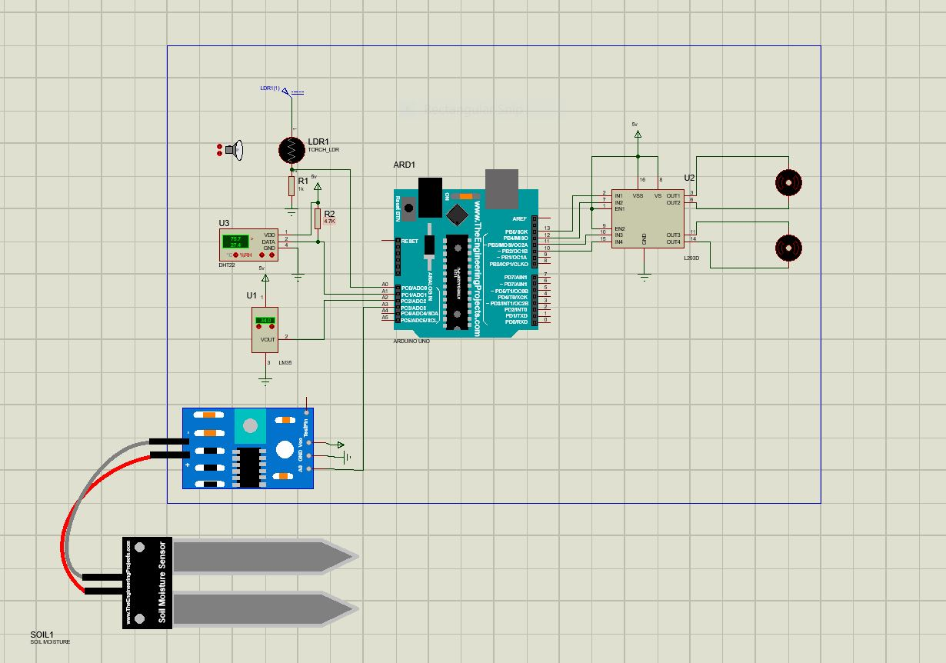
SIMULATION(sensors & motors)

Slide 13
DESIGN
Motors - Single shaft BO motor x 4
specifications- 150 rpm, power requirement- 5V, 40mA, Torque- 0.8Kgcm, size: 55 x 48 x 23 mm.
Light Sensor- BH1750 - Light Intensity Sensor Module
specifications- Power requirement: 3V-5V, Light range 0-65535 lx, built-in : 16 bitAD converter.
Temperature Sensor - MCP9808 Temperature Sensor Module
specifications- Power requirements: 2.7V to 5.5V, range: -40°C to +125°C, accuracy- ±0.25°C.

Slide 14
Humidity Sensor- DHT22
Specifications- Power requirements: 3.3-5V, range: 0-100% RH, size: 40x15x10 mm
Soil Moisture Sensor- XH-M214
Specifications- Power requirements: 5-12V, range: 20-99%RH, precision: 1%,
size: 52x43x16 mm, weight: 28g
Camera Module-OV7670
OV7670 is a low-cost image sensor, DSP that can operate at a maximum of 30 fps and 640 x 480 (“VGA”) resolutions, equivalent to 0.3 Megapixels.
Specifications- Power requirements: 2.5-3V, Pixel Resolution: 640 X 480, size: 35 x 35 x 30mm

Slide 15
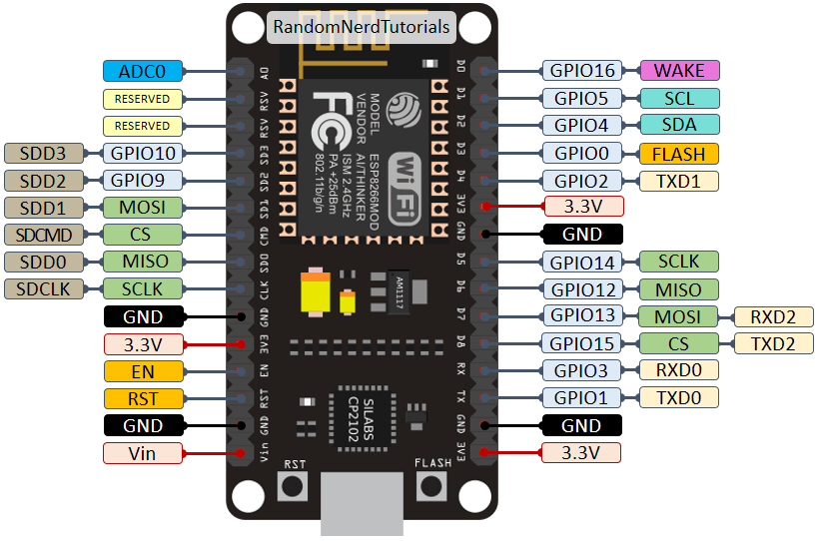
ESP8266
The ESP8266 is a low-cost Wi-Fi microchip, with built-in TCP/IP networking software, and microcontroller capability.This module has a powerful enough on-board processing and storage capability that allows it to be integrated with the sensors and other application specific devices.
Specifications:
Power input: 4.5V ~ 9V, Transfer rate: 110-460800bps, Flash size: 4MByte, Dimensions: 25 x 15 x 11 mm.
Pinout diagram of ESP8266

Slide 16
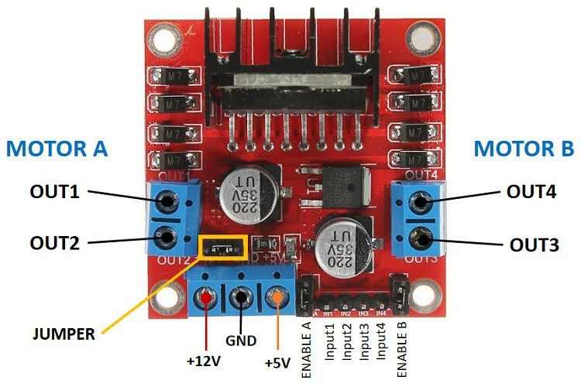
L298N Motor driver
This L298N Motor Driver Module is a high power motor driver module for driving DC and Stepper Motors. This module consists of an L298 motor driver IC and a 78M05 5V regulator. L298N Module can control up to 4 DC motors, or 2 DC motors with directional and speed control.
Specifications:
Driver Voltage: 5-35V, Driver Current:2A(max), Max Power: 25W, Dimensions in 44 x 44 x 28mm,

Slide 17
M4
M1
Battery Pack
BH1750
ESP32
L298N
DHT22
HC-05
M4
OV7670
Servo
M2
Rough layout of project
XH-M214

Slide 18
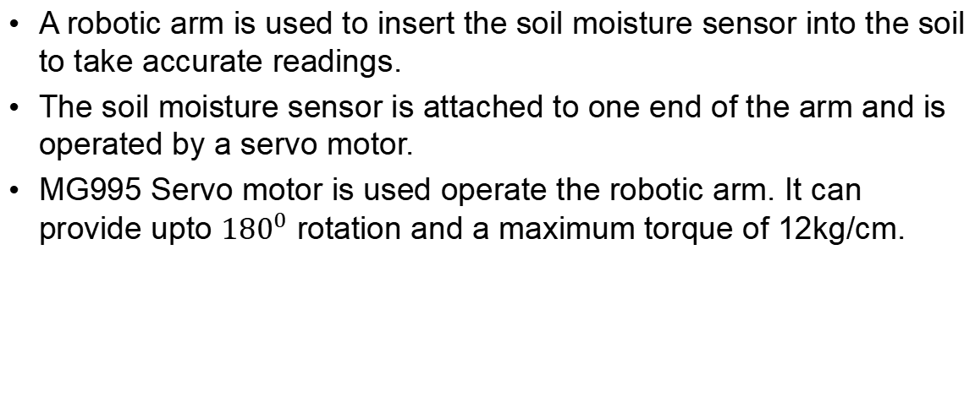
ROBOTIC ARM
A robotic arm is used to insert the soil moisture sensor into the soil to take accurate readings.
The soil moisture sensor is attached to one end of the arm and is operated by a servo motor.
MG995 Servo motor is used operate the robotic arm. It can provide upto ${180}^{0}$ rotation and a maximum torque of 12kg/cm.

Slide 19
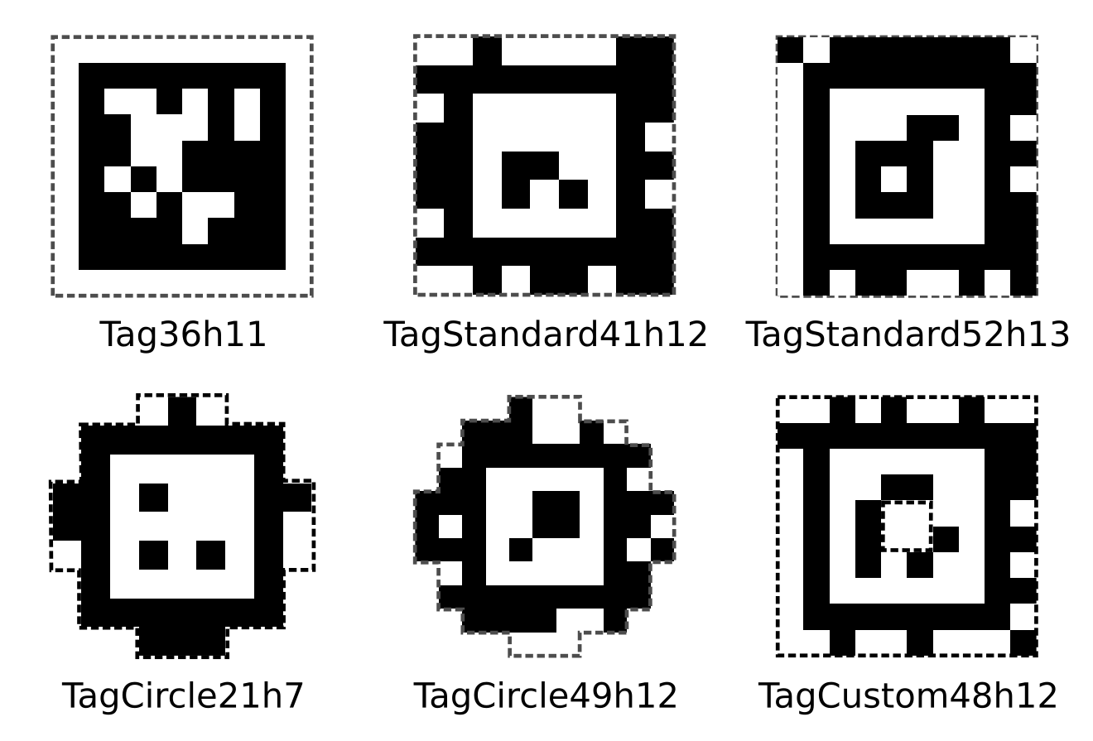
ALGORITHMS
April tag - for area identification.
AprilTag is a visual fiducial system, useful for a wide variety of tasks including augmented reality, robotics, and camera calibration. Targets can be created from an ordinary printer, and the AprilTag detection software computes the precise 3D position, orientation, and identity of the tags relative to the camera.

Slide 20
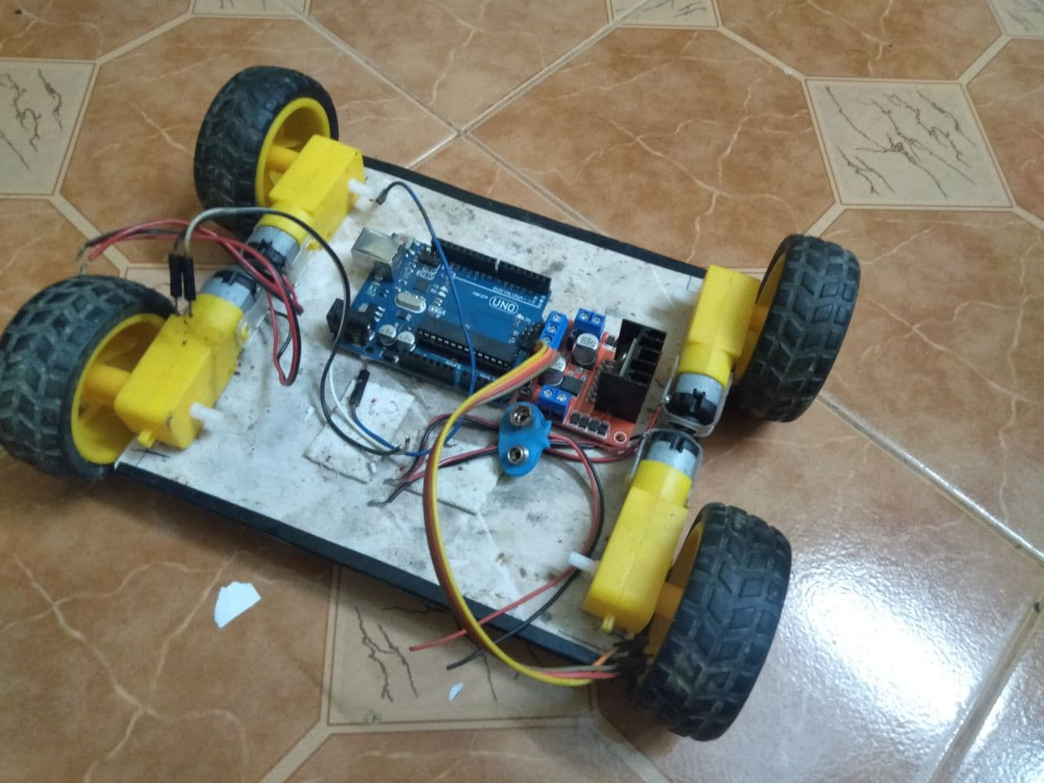
PROGRESS
Implemented 4 wheel drive system using motor controller.
Added light and temperature sensors.
Added bluetooth module.
Tested the IoT board.

Slide 21
UPCOMING OBJECTIVES
Inclusion of humidity and soil moisture sensor.
Construction of chain track and robotic arm.
Addition of solar panel and charge controller.
Implementation of camera module.
Implementaion of April tag for area indentification.
Interfacing of IoT board.
Setting up wireless control of water pump and irrigation system.

Slide 22
REFERENCES
1.A. Daccache, J. W. Knox, E. K. Weatherhead, A. Daneshkhah and T. M. Hess, "Implementing precision irrigation in a humid climate–recent experiences and on-going challenges", Agricult. Water Manage., vol. 147, pp. 135-143, Jan. 2015.
D. K. Fisher and H. Kebede, "A low-cost microcontroller-based system to monitor crop temperature and water status", Comput. Electron. Agricult., vol. 74, no. 1, pp. 168-173, Oct. 2010.
Chen, Qi, Gui, Gu, Ma, Zeng, et al., "A model-based real-time decision support system for irrigation scheduling to improve water productivity", Agronomy, vol. 9, no. 11, pp. 686, Oct. 2019.
N. Romano, "Soil moisture at local scale: Measurements and simulations", J. Hydrol., vol. 516, pp. 6-20, Aug. 2014.

Slide 23
THANK YOU

